Slide 1
UNIT3
Elements and Principles of Design
Objective: Learn and apply elements and principles of design in a product that is used in advertising.
Essential Question: Find elements and principles of design and explain how and why they are used.
Assignment: Create a new folder (unit 3), create new PP. Unit Project will include a book that includes all the elements and principles in advertising.

Slide 2
Line
Shape/Form
Size
Texture
Color
Taste
Smell
Hearing
Typography
Elements of Design

Slide 3
Principles of Design
Contrast
Alignment
Balance
Repetition
Proximity (Unity)
White Space
Rule of Thirds

Slide 4
Project due at this end of this unit
Using magazines you will create a book to include all the elements and principles used in advertising.
Mount each picture on a white sheet of paper. On the back of the picture, explain the element or principle used and why in 5 complete sentences. One picture per page.

Slide 5
UNIT3
Elements and Principles of Design
Objective: Elements of Line and Shape
Essential Question: Find elements of line and shape in an advertisement and explain how and why it was used.
Assignment: Define elements, and line and shape elements and find an ad and describe both elements.

Slide 6
Elements of Design- are the building blocks of art. The elements are to express ideas, just as a writer uses words to express ideas, viewers can see and touch them with their senses. Elements are used to draw attention to a particular part of an ad.

Slide 7
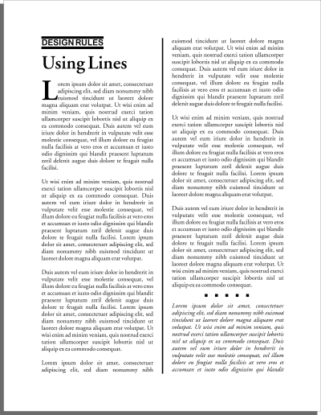
Practical Use of Elements
Organize, connect, separate
Create movement
Provide texture
Convey a mood or emotion
Define shapes
Provide emphasis
Provide a framework
Make a statement

Slide 8
Lines- a mark, or stroke that is longer then it is wide. It is the path of a point moving in space. Objects and things are perceived by the line that describes them. Width, length, direction, focus, feeling
Lines are one of the basic elements of design. Alone or in combination with other lines or shapes they can aid in the readability, appearance, and message of a design.

Slide 9
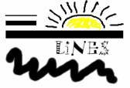
Introduction to Lines as an
Element of Design
Lines can be long or short, straight or curved.
Lines can be horizontal, vertical, or diagonal. They create patterns.
Lines in graphic design can be solid, dashed, thick, thin, or of variable width. Sometimes a designer uses a line alone to divide or unite elements on a page.
Lines can denote direction of movement (as in diagonal lines and arrows) or provide an anchor to hold elements on a page (such as lines at the top, bottom, or sides of a page).
You can use lines in conjunction with other elements of your design. One well-known example, the AT&T logo, is a pattern of thick and thin lines arranged in a circular shape.

Slide 10

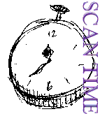
A few simple lines added to a piece of clip art gives a sense of movement to the airplane. Short, choppy, vertical lines create a grooved texture along the edge of the timepiece sketch.

Slide 11

Dashed lines suggest a coupon, whether there is one or not. It causes many of us to take a second look at this ad because the familiar dashed line makes us think "I can save money!"

Slide 12
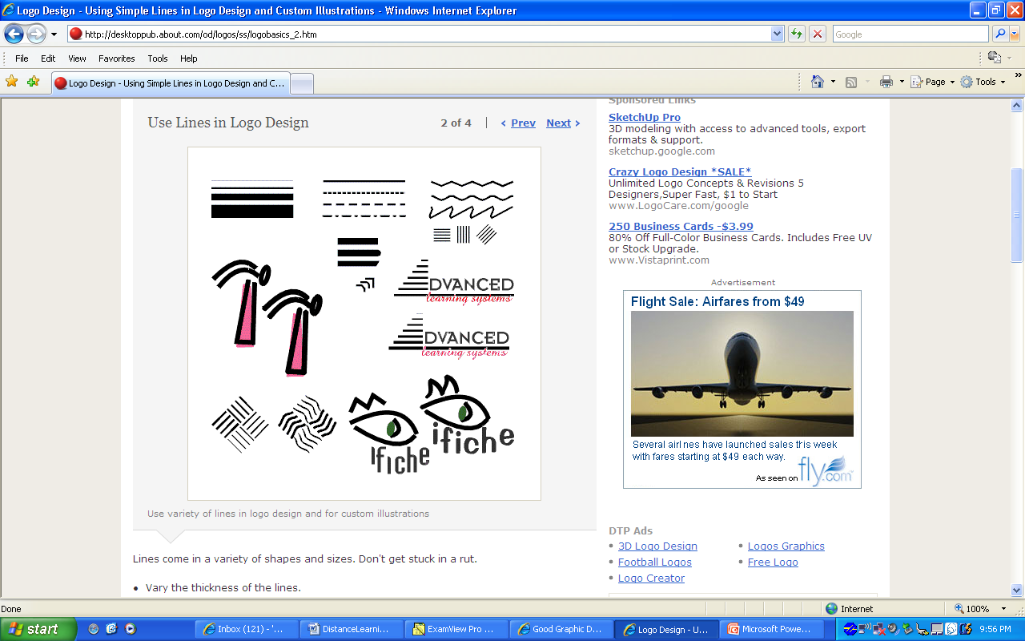
Use lines to form barriers.
Use lines to indicate connections.
Use lines to show movement.
Be aware of what the shape of lines can convey.
Sharp edges could indicate tension, crispness, hardness, formality, or high tech.
Soft edges and curves may be softer, flowing, more casual, or more personal.
Even small changes in line thickness, endings, or shape changes can alter the look and feel of a design.
In the "Advanced" logo design example, the lines that make up the triangle (letter A) go from thick at the bottom to thin at the top. They also suggest a set of steps (advancement) leading upward.
Notice how the round line endings give the hammer -- drawn freehand with straight and curved lines -- a softer feel.
The second version of the ifiche logo design uses rounded line endings and more curves (in the fins/lashes). Notice that a different typeface is chosen for each, to match the style of lines.
You can also create interesting patterns with a series of repeating lines. None of these designs rely on color -- although changes in color can further change the appearance of the lines.

Slide 13
Elements of shapes

Slide 14
Shape/Form- is the external outline of an object. It is two-dimensional. Form is a shape that is three-dimensional. Organic, inorganic, open forms, closed forms, geometric shapes, geometric forms, and free form.
Shape is one of the basic elements of design. Alone or in combination with other shapes or lines they can convey universal meanings as well as guide the eye or organize information. The three basic types of shapes are geometric, natural, and abstract.

Slide 15
Square Shapes
To symbolize honesty, stability, equality, comfort, or familiarity. It could also symbolize rigidity or uniformity.
Squares are familiar, trusted shapes. Because the vast majority of the text we read is set in squares and rectangles, it has become familiar, safe, and comfortable.
Some designers might equate square with boring. It's true that other, unexpected shapes, can grab attention better than the simple square but don't forget the importance of comfort and familiarity. Imagine how difficult it becomes to file everyday correspondence if letterhead came in a variety of triangles or freeform shapes. Try reading an entire book with all the text set in circles. Squares and rectangles definitely have a place in design.

Slide 16
Circle Shapes
To symbolize infinity and protectiveness. Circles could also suggest something well-rounded or complete. Similar to protectiveness, circles could also imply security.
They are also protective (think of protective encircling arms). They can also denote free movement such as a rolling ball or a more controlled movement such as a spinning globe.
Outside of logo designs, circles are less common elements of design which makes them good for grabbing attention, providing emphasis, and breaking up familiar rectangular blocks of text. You could set text in circles or simply use a circle as the background for more traditional blocks of text.

Slide 17
Triangle Shapes
Triangles suggest action. They are dynamic. Triangles may convey either conflict or strength. Triangles can direct movement (up, down, left, right — depending on which way they 'point') but rather than moving themselves, they point the way for the reader.
To symbolize action or conflict. In a logo, a triangle might be better suited to a growing, dynamic high tech company than the more stable, familiar square, for example.
Triangles are suggestive of many different shapes and ideas. They can represent a religious Trinity, a pyramid, a flag or pennant, an arrow, a beacon.

Slide 18
Practical Use of Shapes
As with lines, whether shapes appear as part of a graphic element, such as a logo or illustration, or the shapes themselves are the graphic element, such as frames or boxes, use them purposefully in the overall design.
Some ways that you might use shapes in your design are to:
    Organize, connect, separate
    Symbolize an idea
    Create movement
    Provide texture or depth
    Convey a mood or emotion
    Provide emphasis
    Provide a framework

Slide 19
Geometric Shapes
An octagon, especially a red one, usually means stop.
A starburst is commonly used to grab attention and identify something that is new, improved, or 'on sale.'

Slide 20
Natural Shapes
Natural shapes can add interest and reinforce a theme. Rather than a plain box, frame text with a coiling rope or a spray of leaves or flowers. Use a freeform, non-symmetrical shape to convey a feeling of spontaneity.

Slide 21
Abstract Shapes
Some abstract shapes are almost universally recognized and easily 'read' even when the text is in an unfamiliar language.
The stylized wheelchair, the male and female symbols for restrooms, and the jagged steps for stairs or an escalator are some examples.
Icons are often abstract or stylized shapes. For example, a rectangle with a 'folded corner' often indicates a page in a document or a word processing program.
A hollow circle or oval with smaller circles on the 'path' may be a literal representation of a planetary system or symbolic of a network, such as a computer network.

Slide 22
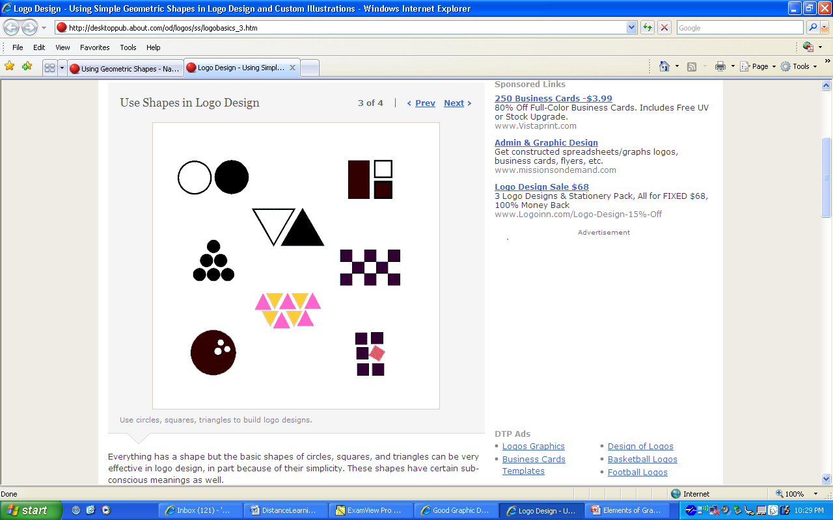
Everything has a shape but the basic shapes of circles, squares, and triangles can be very effective in logo design, in part because of their simplicity. These shapes have certain sub-conscious meanings as well.
The circle is protective or infinite.
The square denotes stability, equality, and honesty.
The triangle suggests tension or conflict or action.

Slide 23
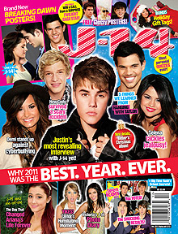
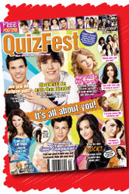
Exercise
Find a magazine advertisement that fits the idea of using lines and shapes. Cut it out and SAVE IT, you will create an element of design book using magazine ads.
Find one in class or do it for homework.

Slide 24
UNIT3
Elements and Principles of Design
Objective: Elements of Size/Mass and Texture
Essential Question: Find elements of size/mass and texture in an advertisement and explain how and why it was used.
Assignment: Define size/mass and texture elements and find an ad and describe both elements.

Slide 25
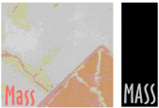
Introduction to Mass as an
Element of Design
Mass is size. There is physical size and visual size.
to create contrast
Example: A designer might design a full-page magazine ad using a single small image in the middle of the page with lots of white space. The contrast between the size of the page and the size of the content (image) draws attention to the image and can create a specific mood (depending on other elements) such as conservative, elegant, lonely, or open.
Larger font
Image that is out of the ordinary size as dipicted in ad.

Slide 26
Exercise
Find a magazine advertisement that fits the idea of using mass. Cut it out and SAVE IT, ad it to your project book.

Slide 27
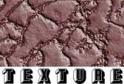
Introduction to Texture as an
Element of Design
For desktop publishing, actual texture is the feel of the paper.
Is it smooth to the touch or rough?
Textures can also be visual. On the Web, especially, backgrounds that simulate familiar fabrics, stone, and other textures are common.
Can you tell by looking whether a paper will be soft and smooth or rougher?
Are the visual textures used in place of actual papers of that texture or do they relate in some way to the purpose of the printed piece (such as a stone texture for a tile company)? See and feel the difference in textures on embossed pieces or other types of raised printing.

Slide 28
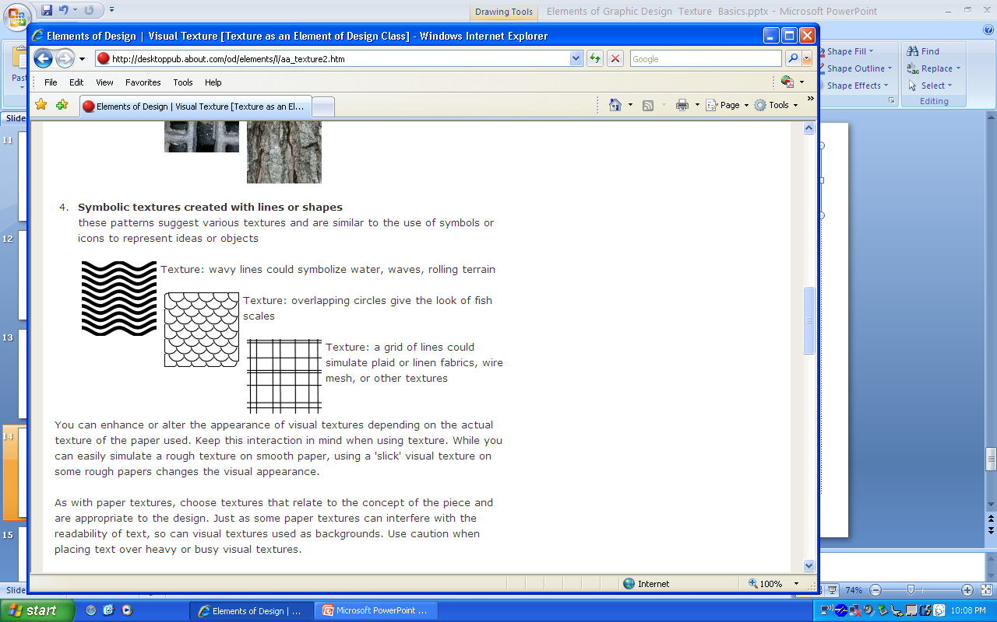
Symbolic textures created with lines or shapes

Slide 29
Exercise
Find a magazine advertisement that fits the idea of using TEXTURE. Cut it out and SAVE IT, you will create an element of design book using magazine ads.
Find one in class or do it for homework.

Slide 30
UNIT3
Elements and Principles of Design
Objective: Elements of color
Essential Question: Find elements of color and explain how and why it was used.
Assignment: Find an ad elements of color and explain how and why it was used.
See color theory PP

Slide 31
Digital Design 2/3
Objective: Pass industry certification
Essential Question: Write down questions from test to study that are essential to passing the test. Look up the answers after taking the test so you can study them.
Assignment: Take notes, you will receive a grade on the notes you take for the test. It is a daily work grade based on your notes. Then answer them and study them for the next test. You cannot use your notes on the test. You must study.

Slide 32
UNIT3
Elements and Principles of Design
Objective: Elements of typography
Essential Question: Find elements of typography.
Assignment: Find an ad elements of typography and explain how and why it was used.

Slide 33
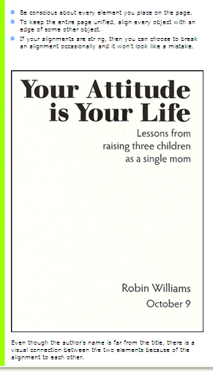
Alignment
The example on the previous page is also aligned - a centered alignment. As you can see, though, a flush left or flush right alignment (as shown above) gives a stronger edge, a stronger line for your eye to follow.
A flush left or flush right alignment often tends to import a more sophisticated look than does a centered alignment.

Slide 34
Typography
Type a text that looks like a scary movie
Type a text that looks like a Heaven’s day spa
Type a text that looks like a security company
Type a text that looks humurous or funny
Type a text that looks like a broadway show
Type a text that looks like a shakespeare play

Slide 35
Find an ad that has typography, explain in 5 complete sentences.
What is the element doing?
  Draws the readers attention
  How does it make you feel
  Purpose of the element: Rule of thirds may apply depending the placement of the element

Slide 36
UNIT3
Elements and Principles of Design
Objective: Elements of the senses: smell, taste, hearing, and touch.
Essential Question: Find elements of each of the four senses: smell, taste, hearing, and touch.
Assignment: Find an ad elements of each of the four senses and explain how and why it was used.

Slide 37
Principles of Design
Objective: Learn about principles of Design. This puts the elements all together in an ad
Contrast
Alignment
Balance
Repetition
Proximity Unity
White Space
Pattern
Essential question: Describe the following principles in 5 complete sentences in ads that you find.
Assignment: Find ads for each principle.

Slide 38
Principles of Design
The principles of design suggest effective and pleasing ways to arrange text and graphics on the page as well as the arrangement of individual elements within illustration, logos, and the overall graphic design of a document. Generally, all the principles of design apply to any piece you may create. How you apply those principles of design determines how effective your design is in conveying the desired message and how attractive it appears.

Slide 39
Contrast
Contrast is one the principles of design. Contrast occurs when two elements are different. The greater the difference the greater the contrast. The key to working with contrast is to make sure the differences are obvious. Four common methods of creating contrast are by using differences in size, value, color, and type.

Slide 40
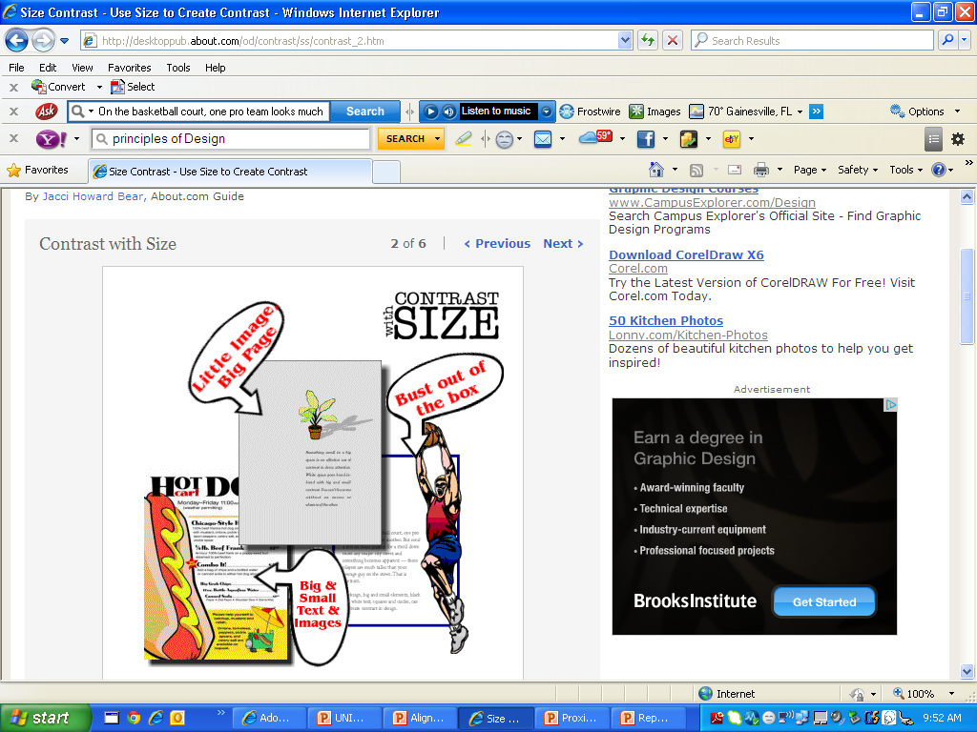
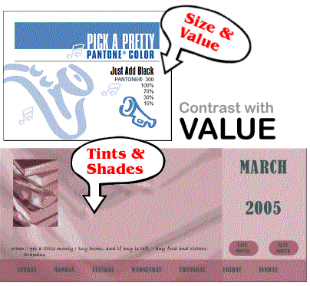
Contrast
On the basketball court, one pro team looks much like another. But send a few of those players for a stroll down most any major city street and something becomes apparent — those players are much taller than your average guy on the street. That's contrast. In design, big and small elements, black and white text, squares and circles, can all create contrast in design.

Slide 41
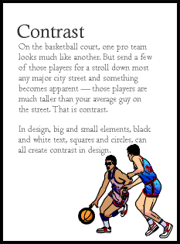
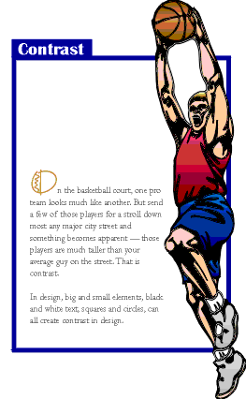
Contrast
Notes:
There's isn't enough contrast between the headline and text due in part to size but also because the two different serif faces used or too similiar (not obvious from the small graphic, trust me, they are different typefaces).
That oversized graphic provides real contrast and reinforces the copy (tall basketball players). Dropping the text down to the bottom portion of the page also reinforces the 'towering' aspect of the graphic. The reversed text in the blue box,the blue border, and the drop cap carries through the overall unifying elements found throughout the series. Additionally, the round shape of the drop cap and its color echo the shape and color of the basketball in the graphic. The drop cap and the reversed text on the left side plus the left-aligned text help to balance the large graphic element.
That oversized graphic provides real contrast and reinforces the copy (tall basketball players). Dropping the text down to the bottom portion of the page also reinforces the 'towering' aspect of the graphic. The reversed text in the blue box,the blue border, and the drop cap carries through the overall unifying elements found throughout the series. Additionally, the round shape of the drop cap and its color echo the shape and color of the basketball in the graphic. The drop cap and the reversed text on the left side plus the left-aligned text help to balance the large graphic element.

Slide 42
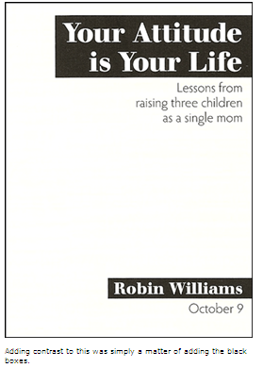
Contrast
Would you agree that the example on this page attracts your eye more than the example on the previous page? It's the contrast here, the strong black versus white, that does it.
You can add contrast in many ways:
rules (lines)
typefaces
colors
spatial relationships
directions, etc .

Slide 43
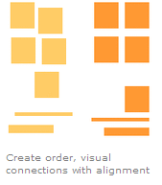
Alignment
Alignment is the placement of text and graphics so they line up on the page. It's one of the principles of design that help us create attractive, readable pages. Use alignment to: create order
organize page elements
group items
create visual connections
Good alignment is invisible. Most readers won't consciously notice that everything is lined up neatly but they will feel it when things are out of alignment.

Slide 44
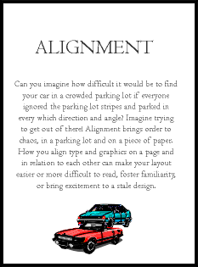
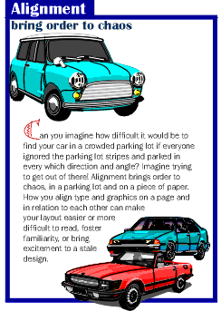
Alignment
Notes:
In the second "Alignment" example, text alignment is left-aligned, ragged right, wrapped around the bottom graphic which is aligned more to the right, opposite an added graphic that is aligned to the right to help balance the overall design.

Slide 45
Alignment
There are several types of alignment that can work together to create a pleasing layout.
horizontal alignment
In horizontal alignment left and right margins are exactly or visually equal. Horizontal alignment can be across the page or within columns. It doesn't necessarily mean center alignment. A block of flush left/ragged-right text can be aligned horizontally. Even though individual lines of text are not perfectly aligned on each side, careful attention to the amount of rag (white space at the end of the line) can result in a visually balanced amount of margin on each side of the block of text.
vertical alignment
In vertical alignment the top and bottom margins are exactly or visually equal. Vertical alignment can be the full page or within portions of the page.
edge alignment
Edge alignment lines up text or objects along their top, bottom, left, or right edges.
center alignment
Center alignment may be horiztonally or vertically aligned, or both.
visual or optical alignment
Visual or optical alignment fixes some of the problems that can occur with other types of alignment due to the varying shapes of letters and graphics. In visual alignment the objects may not be precisely aligned but to the eye they appear lined up.

Slide 46
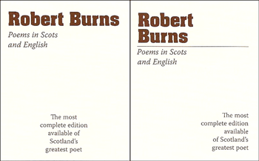
Title Page
Which one do you like better?

Slide 47
Balance
Primarily there are three types of balance in page design:
symmetrical
asymmetrical
radial

Slide 48
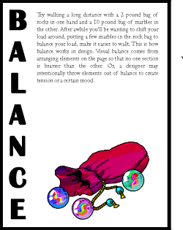
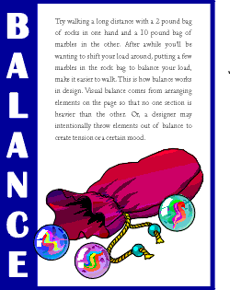
Balance
Notes:
To tie the elements together, move them closer together (resizing helps accomplish this). Notice that the graphic (one of the marbles) slightly overlaps the box enclosing the vertical text, unifying the two elements. Reversing the word "balance" out of the blue box also adds more contrast to the composition. The increased leading in the text block redistributes the white space in a more balanced manner.

Slide 49
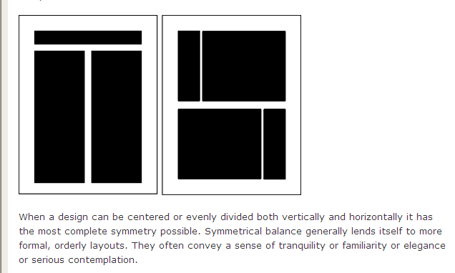
Symetrical

Slide 50
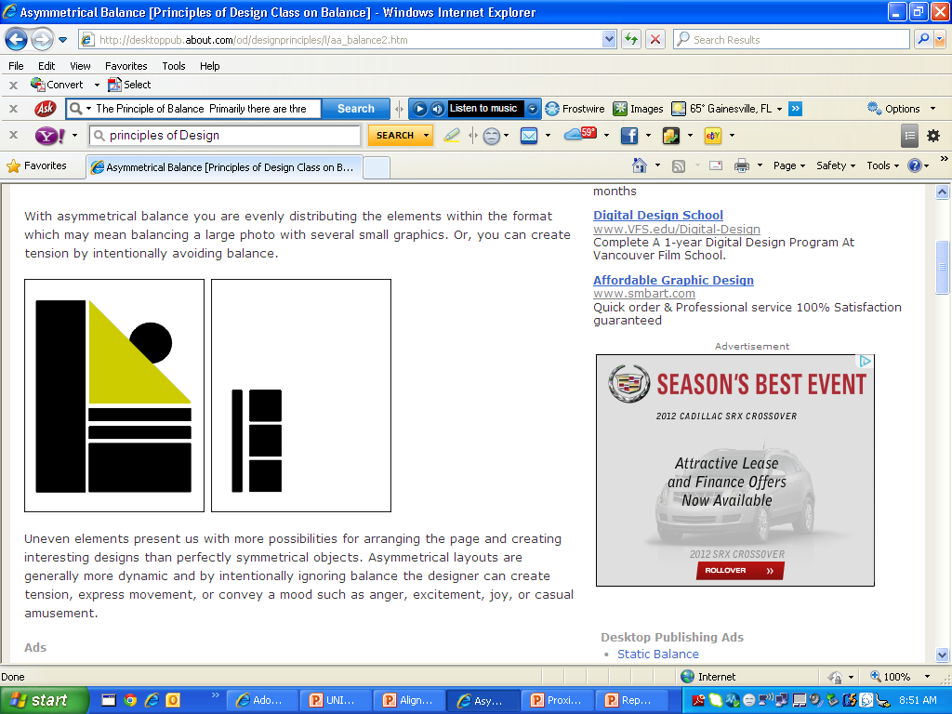
Asymmetrical

Slide 51
Radial
It relates to images emitting from a point like spokes in a wheel or ripples from a pebble thrown in the ocean.

Slide 52
Repetition
Readers gain comfort from having certain elements repeat themselves at consistent intervals or in the same position. It is much easier to flip to the desired page of a magazine if the reader knows that the page number will be in the same location on every page. Specific columns or special sections of a newspaper are more readily recognized, even when they change location, if they look the same from issue to issue.

Slide 53
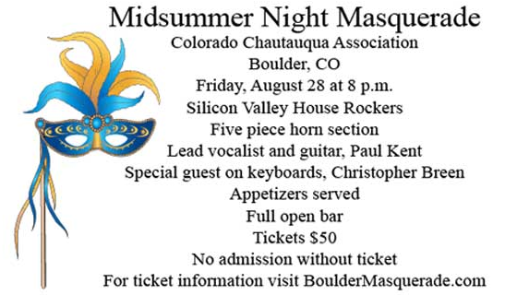
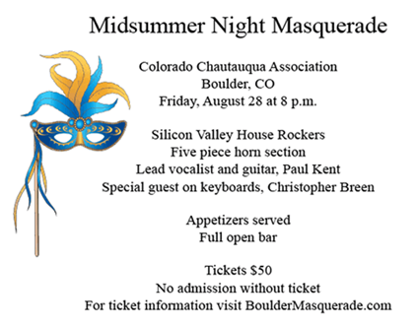
Proximity (unity)
Placing like objects or text together in close proximity.
The basic purpose of proximity is to organize.

Slide 54
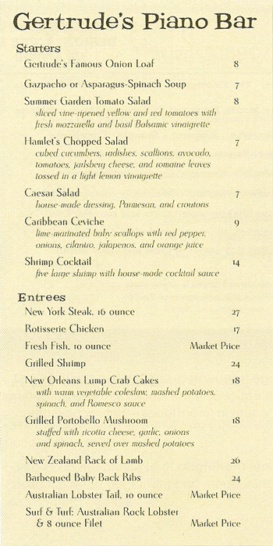
Proximity (unity)

Slide 55
White Space
White space is an important principle of design missing from the page layouts of many novices. White space is nothing. White space is the absence of text and graphics. It breaks up text and graphics. It provides visual breathing room for the eye. Add white space to make a page less cramped, confusing, or overwhelming.

Slide 56
White Space
Here's How:
Increase paragraph spacing.
Use a line of space or a deep indent (but not both) to put white space between paragraphs.
Increase space between columns of text.
Alleys or gutters that are too narrow cause the eye to skip over to the next column. Put white space between columns with adequate alleys.
Put space at the end of lines of text.
Use ragged-right alignment to add white space between columns and at the end of lines of text.
Put more space around outer edges of page.
If space is necessarily cramped within the body of the publication, add white space with generous margins or gutters.
Leave more room around graphics.
When wrapping text around graphics or wherever text and graphics meet, provide plenty of standoff white space. Don't run text right up to the edge of graphics.
Increase space around headlines.
Add white space between headlines or subheads and the preceding copy and a bit below as well.
Increase space between lines of type and individual characters.
Add typographic white space by increasing the leading of body text, using lighter type, avoiding letterspacing that is too tight, and avoiding unending condensed or heavy type.

Slide 57
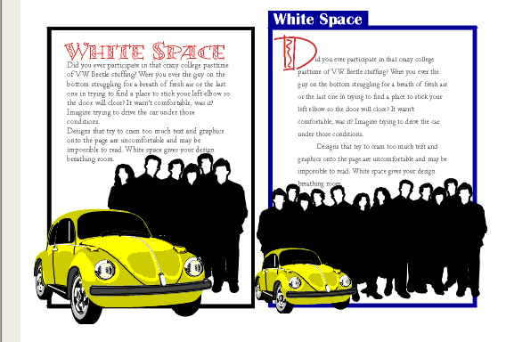
White Space
Notes:
White space doesn't have to be white. The large block of black created by the graphic of people adds a large block of black white space. Multiplying the number of people and reducing the size of the car in the second "White Space" example provides additional contrast and reinforces the theme of the copy. Additional leading, larger margins, deeper paragraph indents all add white space or breathing room to the design.

Slide 58
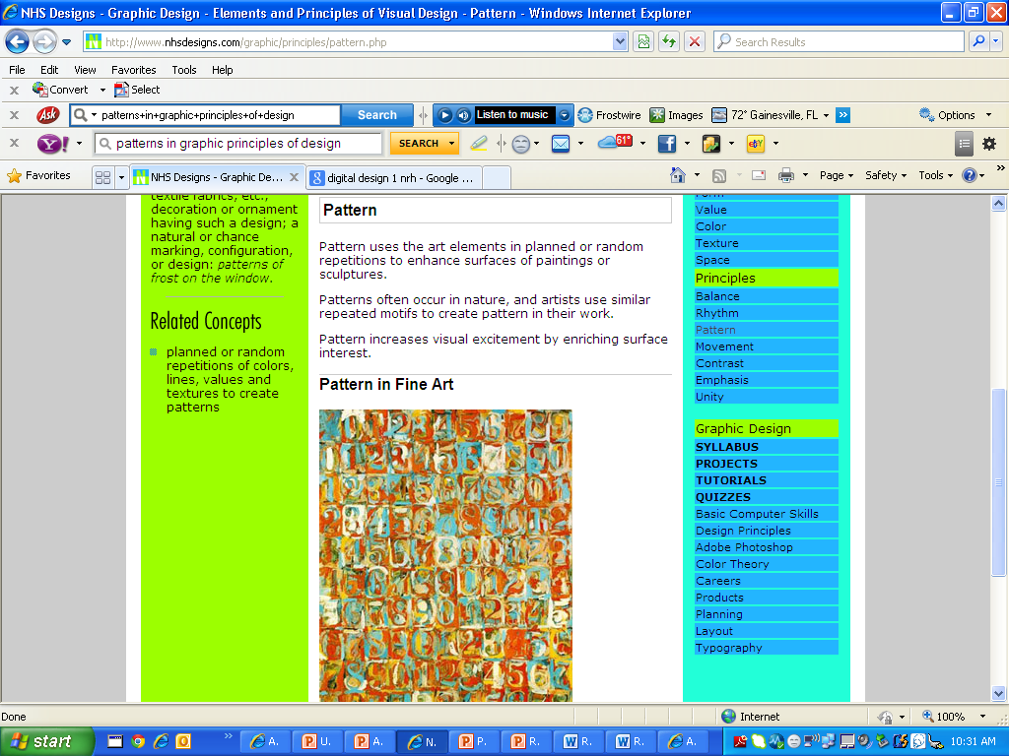
Pattern
The pattern in Johns' painting is regular, consisting of 121 rectangles stacked in eleven rows, each with eleven rectangles. The numbers (0-9) seem irregular because of the irregular use and application of color. There is no focal area in many patterned paintings.

Slide 59
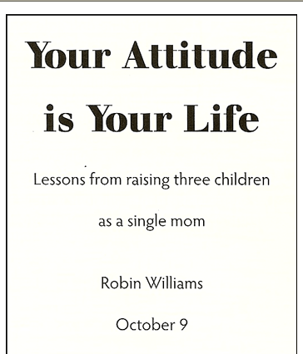
A rather typical but dull report cover: centered, evenly spaced to fill the page. If you didn't read Eng lish, you might think there are six separate topics on this page. Each line seems an element unto itself.

Slide 60
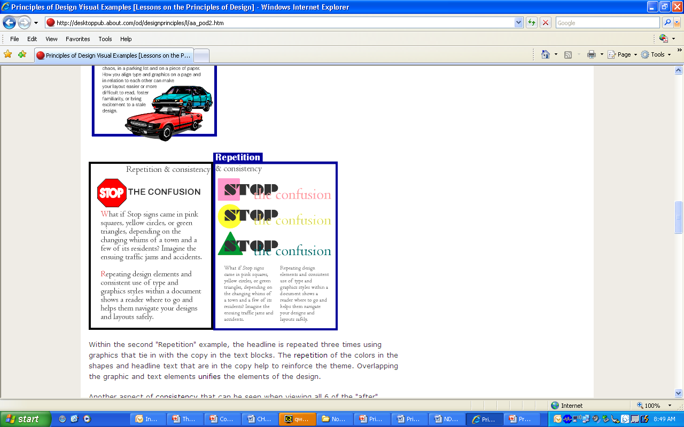
Repetition
Notes:
Within the second "Repetition" example, the headline is repeated three times using graphics that tie in with the copy in the text blocks. The repetition of the colors in the shapes and headline text that are in the copy help to reinforce the theme. Overlapping the graphic and text elements unifies the elements of the design.
Another aspect of consistency that can be seen when viewing all 6 of the "after" examples is the blue borders, blue reversed boxes, and the typeface (Britannic Bold) used for the names of all the principles of design. The drop cap used in three examples (Bermuda LP Squiggle) is another element of consistency.
Within the second "Repetition" example, the headline is repeated three times using graphics that tie in with the copy in the text blocks. The repetition of the colors in the shapes and headline text that are in the copy help to reinforce the theme. Overlapping the graphic and text elements unifies the elements of the design.
Another aspect of consistency that can be seen when viewing all 6 of the "after" examples is the blue borders, blue reversed boxes, and the typeface (Britannic Bold) used for the names of all the principles of design. The drop cap used in three examples (Bermuda LP Squiggle) is another element of consistency.

Slide 61
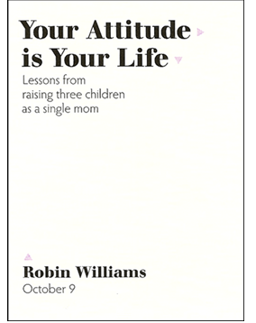
Repetition
Repetition is a stronger form of being consistent.
Look at the elements you already repeat (bullets, typefaces, lines, colors, etc.): see if it might be appropriate to make one of these elements stronger and use it as a repetitive element.
Repetition also helps strengthen the reader's sense of recognition of the entity represented by the design.
The distinctive typeface in the title is repeated in the author's name, which strengthens their connection even though they are physically far apart on the page. The font for the other text is now in the light weight.
The small triangles were added specifically to create a repetition. Although they point in different directions, the triangular shape is distinct enough to be recognized each time.
The color of the triangles is also a repeated element. Repetition helps tie separate parts of a design together.

Slide 62
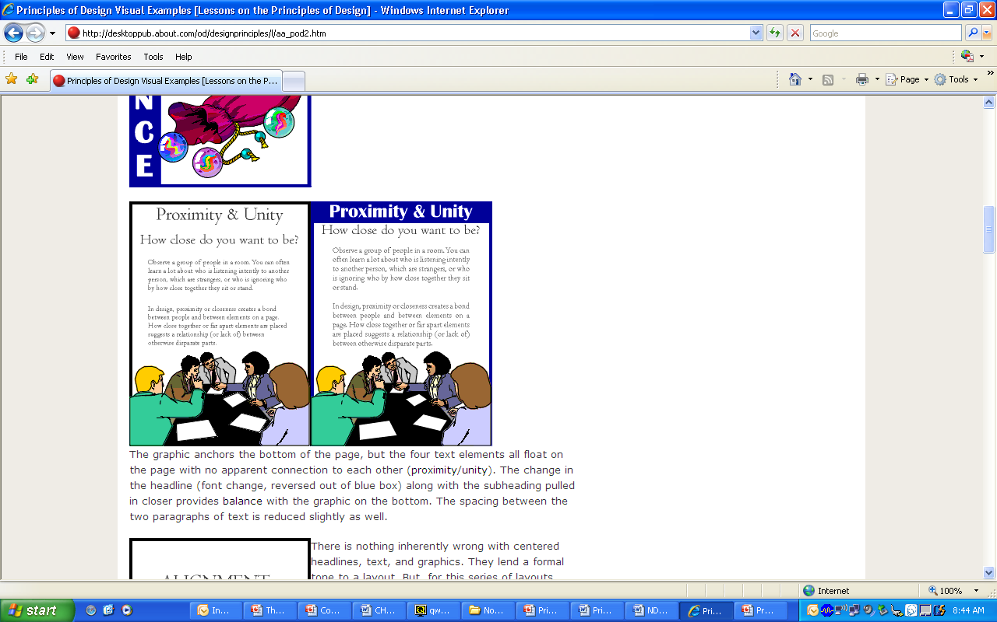
Proximity & Unity
Notes:
The graphic anchors the bottom of the page, but the four text elements all float on the page with no apparent connection to each other (proximity/unity). The change in the headline (font change, reversed out of blue box) along with the subheading pulled in closer provides balance with the graphic on the bottom. The spacing between the two paragraphs of text is reduced slightly as well.

Slide 63
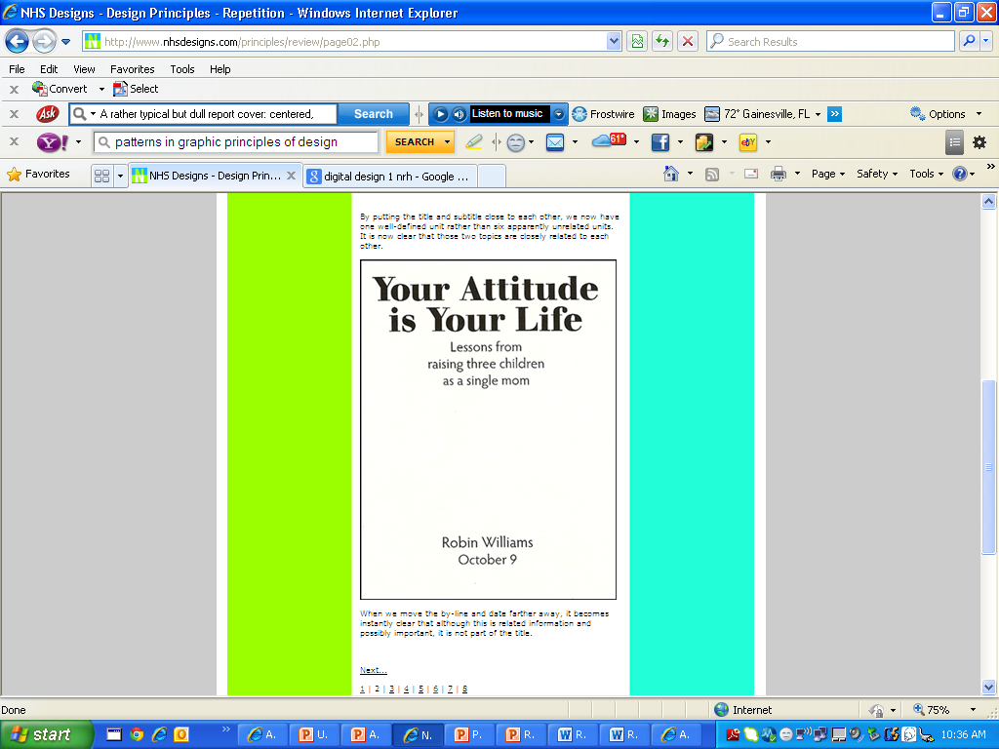
Proximity

