Slide 1
Photoshop Lesson 1 Practice Questions
Shayla Lantz

Slide 2
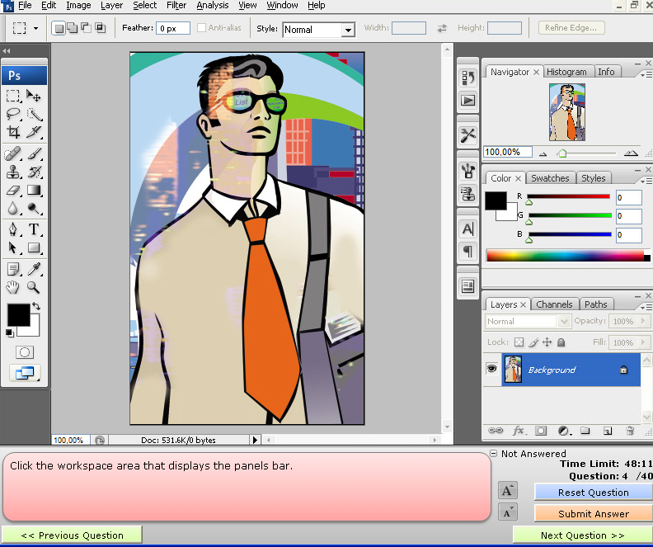
1.)

Slide 3
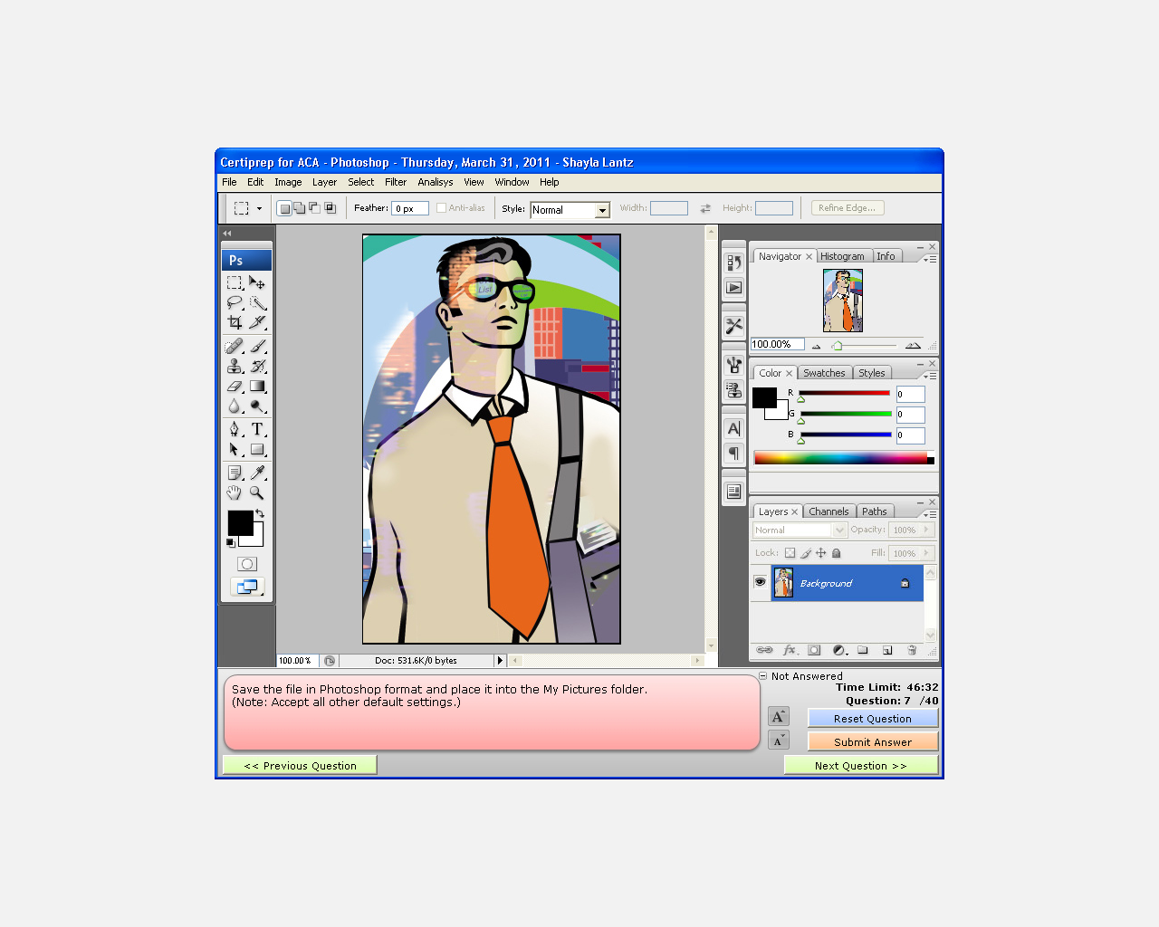
2.)

Slide 4
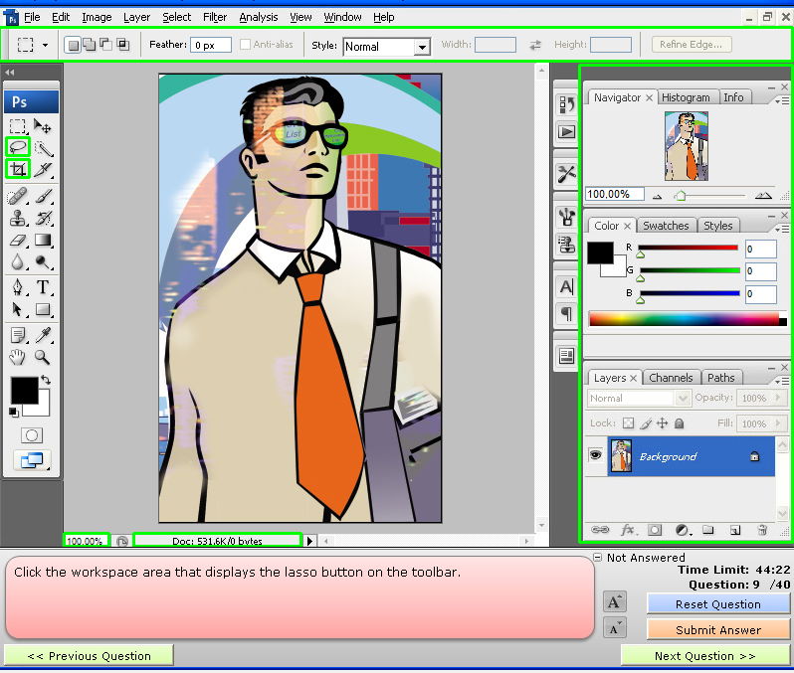
3.)

Slide 5

4.)

Slide 6
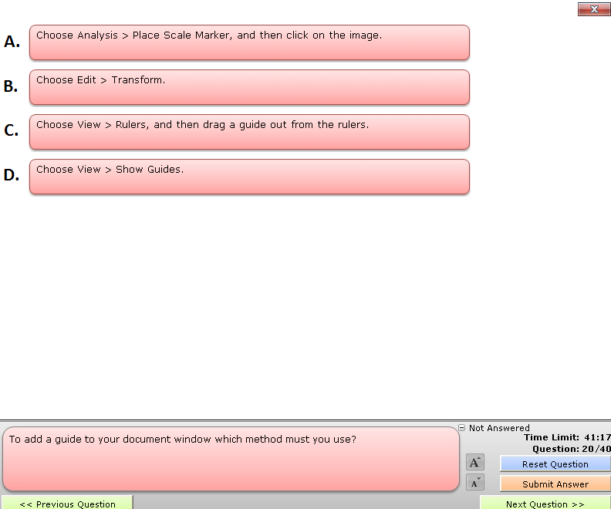
5.)

Slide 7
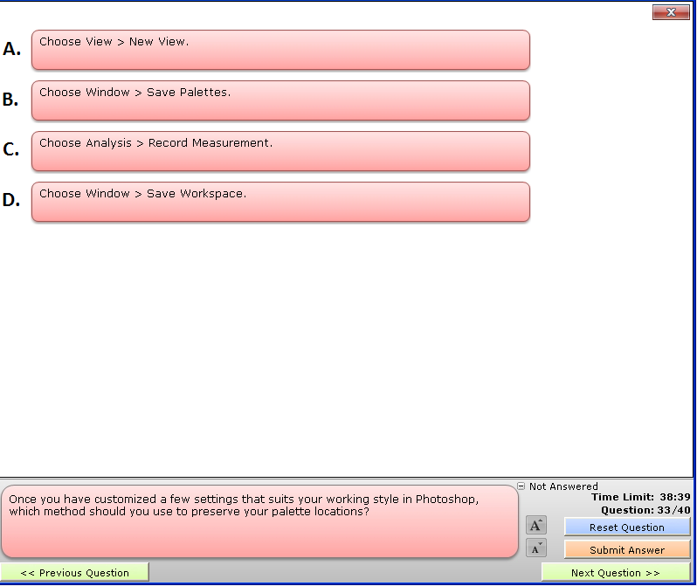
6.)

Slide 8
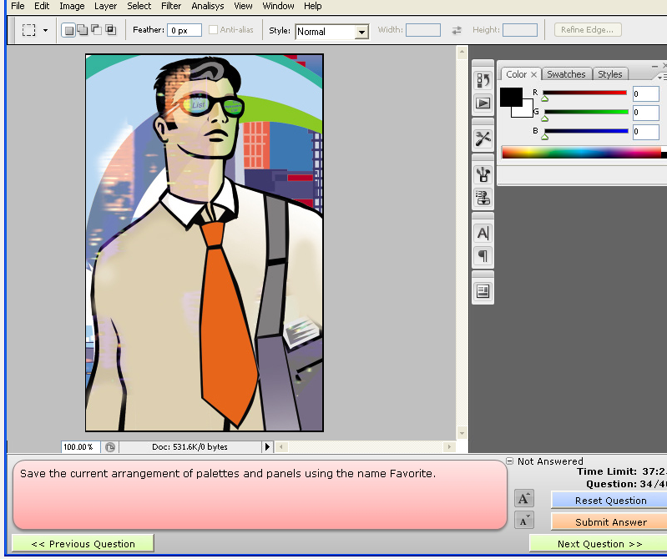
7.)

Slide 9
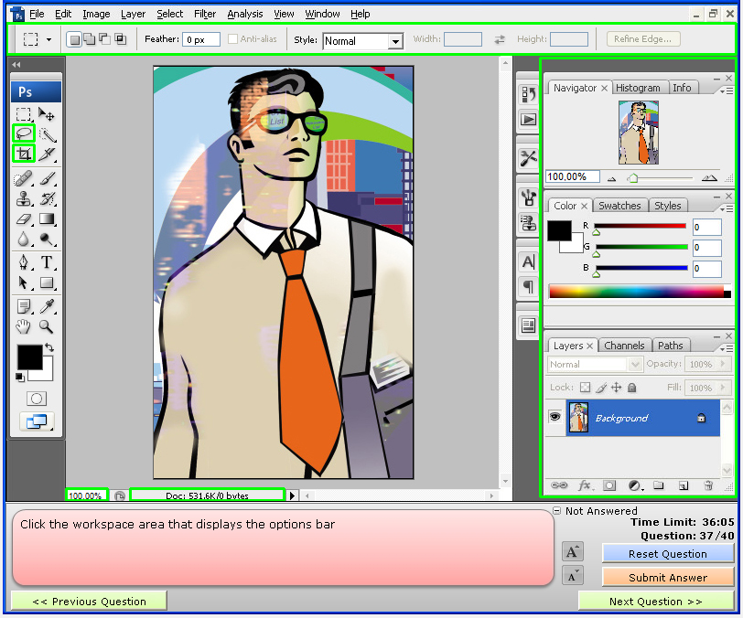
8.)

Slide 10

9.)

Slide 11
10.) Which tool is most appropriate for creating and outline of a ball?
A. Oval Tool
B. Rectangle Tool
C. Line Tool
D. Magnetic Lasso Tool

